Slide 1

Rabies-X
By Team Araguz

Slide 2
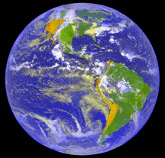
It’s the year 2067. A spaceship is flying through Space. It is operated by a renowned young astronaut named Geraldo Araguz. Araguz served in the Army and is a decorated war hero. His ancestry is Peruvian. The player does not see him yet. Araguz gets a call from the US government. A woman is speaking to him through his intercom.

Slide 3
“Astronaut Geraldo Araguz! This is Special Agent Fiona McDade from the United States Government and I have the most horrific breaking news to deliver! While you were out exploring Space, a horrible new virus has struck planet Earth! This is a terrible tragedy, billions are becoming ill, spreading the infection like a wildfire! Planet Earth needs you, Geraldo Araguz - you have a reputation as the world’s bravest human being! Land your Spaceship in Washington DC next to the Special Agents Building and do not come out. You will still be unprotected as of that moment. Special Agent Damon Viridian and I will come to you right there in our protective suits and we will discuss this terrible disaster in detail. You must come back here this moment, Geraldo Araguz! It’s either you, or no one”.

Slide 4
Araguz: Thank you for informing me of this. Planet Earth needs me. Mother Earth – here I coooooooooooooooome!”
The Spaceship makes a sharp “U-turn” and flies towards planet Earth.

Slide 5
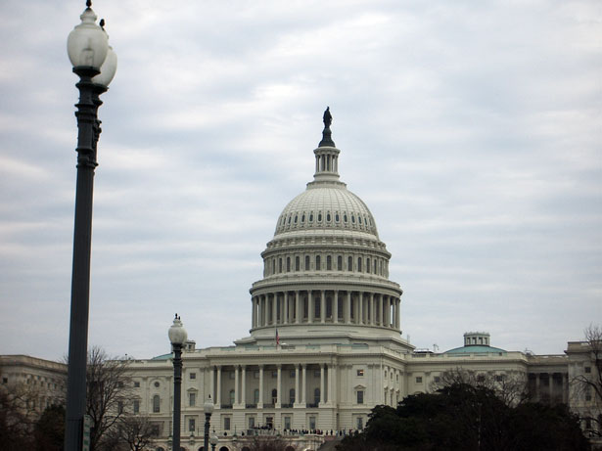
Washington, in 2067: Araguz parks his spaceship by the Special Agents Building.

Slide 6
Araguz: Geraldo Araguz, at your service.

Slide 7
Astronaut Geraldo Araguz. Bravest person in the world and one of the youngest people to be considered a decorated war hero. We finally meet in person. I am Special Agent Damon Viridian and this is Special Agent Fiona McDade – I believe she messaged you about the latest disaster that has struck Planet Earth.

Slide 8
Greetings, Mr. Araguz. We had a group of scientists test out a sample of this catastrophic virus after taking it from a dead victim. The scientists have concluded that this is a new, more terrible than ever before, form of the rabies virus.

Slide 9
They say it’s highly contagious. Once a human being gets it…

Slide 10
“...that human being will go through a terrible, terrible transformation. The body, the face – it will just be horrifying. The human will infect. The human will attack. The US Government has ordered a mandatory quarantine of each and every human being that hasn’t been affected.”

Slide 11
The humans won’t die so quickly. They will stay in this form for months prior to death. Maybe years. We have ordered everyone to stay inside their homes. Lock your doors. Lock your windows.

Slide 12
Humans aren’t the only ones affected. Dogs…

Slide 14
…as well as birds…

Slide 15
“…behaving like bats…”

Slide 16
...have been reported to harbor the virus as well. They will try to bite and peck the innocent. Oh, the horror!

Slide 17
We have summoned you, Geraldo Araguz, to give you a mission. You are officially the bravest person on the planet. You are an army soldier like no other. You are tall and strong. Heed my words. It’s either you, or no one.

Slide 18
Now according to the scientists, this virus has obviously been created by an evil genius who holds a big grudge. They are positive he immunized himself against it. Your mission is to find whoever’s responsible and destroy him.

Slide 19
Then you must find the formula to the antidote. Once you do that, our world will be cured. God help those afflicted. God help us all.

Slide 20
Then you must find the formula to the antidote. Once you do that, our world will be cured. God help those afflicted. God help us all.

Slide 21
The United States government has made you something special. In my hand, I hold a special spray. It is truly one of a kind. It will give your existing space suit a protective aura, hence it will make you, Geraldo Araguz, immune to this new Rabies-X.

Slide 22
And we shall now hand you a brand new plasma gun. Your one and only weapon for defense.

Slide 23
Spray your suit with it now. Then please come outside with us. We have another surprise for you.

Slide 24
I have already served my country, now it’s time to serve the world! Do not fear, Geraldo Araguz is here! This anti-Rabies suit looks just dandy. I will honorably wear my space suit on top of your lovely gift. Geraldo Araguz, at your service. I thank you for this mission and I am just honored!

Slide 25
Everyone walks outside of the spaceship. Another surprise from the US government awaits Araguz.

Slide 26

Our mechanics have crafted for you something you are going to love. Use it proudly. Drive it proudly.

Slide 27
Everyone walks outside of the spaceship. Another surprise from the US government awaits Araguz. It’s a GuzCruise!!

Slide 28
Wow, wow, wow – a special type of vehicle on crawlers named after me - the GuzCruise. And I, Geraldo Araguz, now get my own GuzCruise. Hello, new friend. I will now name you Isabella. You and I are going to spend a lot of time together. Thank you US Government! I, Geraldo Araguz will get the mission done. We will not lose with Geraldo Araguz! And you may call me Gerry.

Slide 29
The fate of Mother Earth rests in your hands. Good luck Geraldo Araguz, Mother Earth believes in you!!!!

Slide 30
Be careful!!!!

Slide 31
Planet Earth can count on me. Just call me Gerry! Araguz out.

Slide 32
And the fate of Geraldo Araguz now rests in your hands!!

